Slide 1
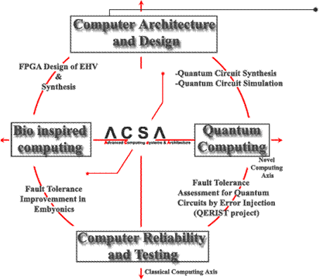
Calcul Reconfigurabil
S.l.dr.ing. Lucian Prodan – Curs 5

Slide 2
Despre ce vorbim ?
✓
DESIGN-UL CIRCUITELOR
Elemente logice
Interconexiuni
Programare
APLICAŢII
Procesarea imaginilor
Procesarea aritmetică în VF
Calcul tolerant la defecte – Embryonics
Procesarea în reţea
⇨

Slide 3
Procesarea imaginilor
Compresia imaginilor
Recunoaşterea imaginilor
Fiecare generaţie de sateliţi lansaţi de NASA conţin mai mulţi senzori, fiind depăşită capacitatea satelitului de a transfera datele către Pământ
Exemplu:
satelitul Terra conţine 5 tipuri de senzori care colectează date pe 36 de benzi spectrale
Baza de la White Sands, New Mexico, captează datele prin reţeaua Tracking and Data Relay Satellite System (TDRSS) cu o rată de transfer limitată la 150 Mbps

Slide 4
Procesarea imaginilor
Această limitare a dus la necesitatea compresiei de date/imagini
Platformele hardware tradiţionale nu oferă flexibilitatea necesară pentru modificări post-lansare
Soluţia: platforme reconfigurabile (FPGA)
Implementarea unui nucleu de compresie de imagini într-un sistem reconfigurabil, care poate fi reprogramat după lansare
Algoritmul rulează în hardware şi oferă un consum mai mic decât implementări software
Implementarea pe Xilinx Virtex 2000E FPGA

Slide 5
Procesarea imaginilor
Algoritmul ales: SPIHT – Set Partitioning in Hierarchical Trees
Bazat pe tehnici wavelet, oferă următoarele:
Calitate bună a imaginii cu PSNR mare (peak-signal-to-noise ratio)
Codificare şi decodificare rapidă şi progresivă
Posibilitatea de compresie fără pierderi
Poate fi combinat cu tehnici ECC (Error Checking and Correcting) şi pentru rate de transfer fixe
2 faze: transformarea wavelet discretă şi codificarea propriu-zisă

Slide 6
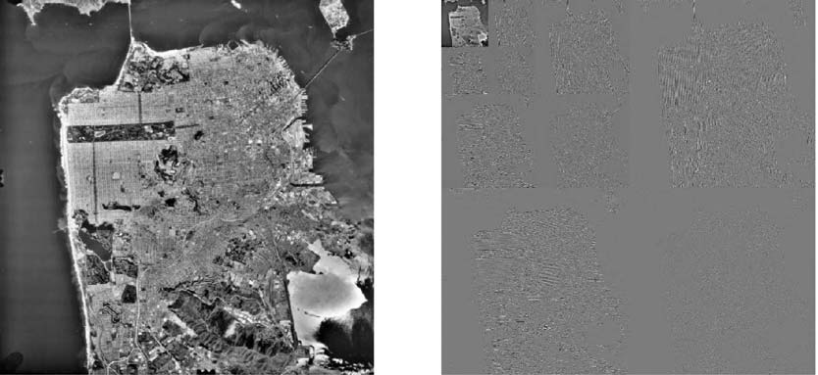
Procesarea imaginilor
O imagine a San Francisco (stânga) şi transformata DWT pe 3 nivele

Slide 7
Procesarea imaginilor
Comparaţie cu IBM RS/6000 Model 270 workstation, rulând SPIHT în software
Imagine 512×512 procesată în 1.101 secunde, fără acces la disk (de 443 de ori mai lent!)
Aceeaşi imagine, cu timpii de acces incluşi, reduce diferenţa la un factor de 31.4x
(Courtesy S. Hauck and A. DeHon)

Slide 8
Embryonics
Chapter 1: Introduction
Brief history of bio-inspiration and bio-inspired hardware
Chapter 2: The Embryonics Project
Basic concepts of Embryonics
Chapter 3: The Architecture
MuxTree architecture and its memory
Chapter 4: The Implementation
Implementation details and operating the MuxTree
Chapter 5: Conclusions
Directions for future work

Slide 9
MuxTree: A New Breed of Bio-Inspired Hardware
Chapter 1: Introduction – Brief History of Bio-Inspiration
Biological organisms
Most intricate structures known
Elements relatively simple: the cells
Highly complex behavior
Massive parallel cooperation
Self-healing and self-reproducing
Computing systems
Performance the primary target
Sufficient level of performance
Another essential target: reliability (self-test and self-repair)
Reliability: present days primary target
Many methods and much work carried along reliable systems
Nature gives a multitude solutions for reliability quest

Slide 10
MuxTree: A New Breed of Bio-Inspired Hardware
Chapter 1: Introduction – Brief History of Bio-Inspiration (2)
Modern computing systems
Architecture increasingly complex
Achieving new levels of performance and reliability more difficult
Re-evaluation of bio-inspiration due to technological advances (FPGA)
John von Neumann, one of the founders of modern computer engineering
Considered bio-inspiration for design of electronic circuitry
Parent of the first self-replicating computing machines
Author of a theory of automata bridging natural systems and computers
His essential message “Genotype + Ribotype = Phenotype” appplied to the universal constructor. The tape stores the information (genotype), the head (ribosome) interprets it, and together they make up the entire machine (phenotype)

Slide 11
MuxTree: A New Breed of Bio-Inspired Hardware
Chapter 1: Introduction – Brief History of Bio-Inspiration (3)
Biological discoveries after death of von Neumann confirm his message
proteins are not made directly from genes
RNA the intermediary messenger
DNA the carrier of information
ribosomes decode RNA, produce proteins

Slide 12
MuxTree: A New Breed of Bio-Inspired Hardware
Chapter 1: Introduction – Bio-Inspired Computer Hardware
Programmable devices the key technology for bio-inspired hardware
Field Programmable Gate Array (FPGA)
2D structure of identical elements
implementation of any kind of digital circuit possible
massive parralelism due to density advantage
one of the Most efficient ways of prototyping
Other advantages for Bio-Inspired Hardware
the circuit layout need be changed by mechanisms implementing self-replication, evolution or healing (self-repair)
on-line hardware evolution possible

Slide 13
MuxTree: A New Breed of Bio-Inspired Hardware
Chapter 1: Introduction – Bio-Inspired Computer Hardware (2)
The Embryonics project
contraction for embryonic electronics
long term research project, LSL Laboratory, EPF Lausanne, Switzerland
bridge between the worlds of biology and electronics
use biologically-inspired mechanisms
Embryonics’ main goals
multi-cellular organization
massive parallel operation of a multitude of simple elements (the cells)
copy of the genome in each cell
self-repair (self-healing) and self-reproduction (self-replication)

Slide 14
MuxTree: A New Breed of Bio-Inspired Hardware
Chapter 1: Introduction – Bio-Inspired Computer Hardware (3)
The Embryonics research team at LSL Laboratory
Prof. D. Mange, project founder and leader
Dr. A. Stauffer, Dr. G. Tempesti
L. Prodan
MuxTree: a new type of FPGA
Bio-inspired electronic molecule
Bio-inspired mechanisms: self-repair and self-replication

Slide 15
MuxTree: A New Breed of Bio-Inspired Hardware
Chapter 2: The Embryonics Project – Introduction
Possibility of modifying hardware by using information demonstrated
Feasibility of creating bio-inspired computer hardware
Electronic organism
2D array of processing elements identical in structure (biological cells)
each element executes a different part of the same program (biological genome)
Entire genome carried by each cell
Biological robustness, consequence of redundancy
Intrinsic suport for self-repair provided by redundancy (spare elements)

Slide 16
MuxTree: A New Breed of Bio-Inspired Hardware
Chapter 2: The Embryonics Project – The Artificial Cell
Artificial cell requirements
Genome memory
Coordinate mechanism
Genome interpreter
Data processing unit
routing unit and connections
MicTree: First implementation of an electronic cell
Puzzle-like structure
Use of an FPGA
Encased in a plastic box called Biodule 601

Slide 17
MuxTree: A New Breed of Bio-Inspired Hardware
Chapter 2: The Embryonics Project – The Artificial Molecule
“Death” of artificial cells very costly
Avoiding possible by:
Each cell made of molecules
A finite number of spare molecules in each cell
Completely homogenous self-repairable FPGA due to different types of molecules required
No such commercial FPGA available
Goal: conception of a new FPGA, capable of self-repair and self-replication

Slide 18
MuxTree: A New Breed of Bio-Inspired Hardware
Chapter 2: The Embryonics Project – The Artificial Molecule (2)
Artificial organism in Embryonics
Three level hierarchy
Organismic level (made of cells)
Cellular level (made of molecules)
Molecular level (basic FPGA element)
Biology | Electronics
Multi-cellular organism | Parallel Computer System
Cell | Processor
Molecule | FPGA Element

Slide 19
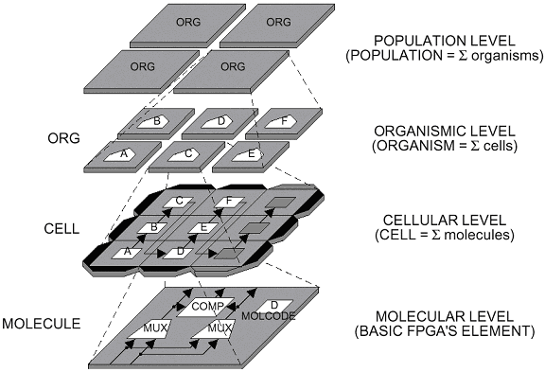
MuxTree: A New Breed of Bio-Inspired Hardware
Chapter 2: The Embryonics Project – The Artificial Molecule (3)

Slide 20
MuxTree: A New Breed of Bio-Inspired Hardware
Chapter 2: The Embryonics Project – The MuxTree
MuxTree basic structure
2D array of elements (the electronic molecules)
programmable function (FU – the functional unit)
based on multiplexers
D-type flip-flop as memory element
programmable connections (SB - the switching block)
a configuration register (CREG)

Slide 21
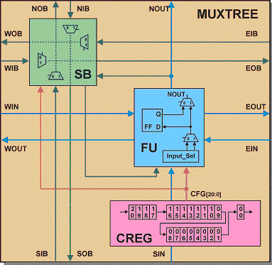
MuxTree: A New Breed of Bio-Inspired Hardware
Chapter 2: The Embryonics Project – The MuxTree (2)

Slide 22
MuxTree: A New Breed of Bio-Inspired Hardware
Chapter 3: The Architecture – Introduction
Data storage required by the genome program
Only one flip-flop available per molecule
Initial MuxTree design ill-suited
Memory the major issue for improvement
memory structures desirable
conventional memory issues not essential

Slide 23
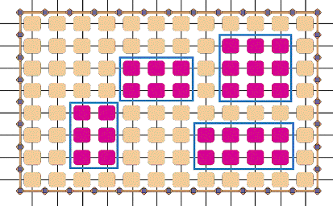
MuxTree: A New Breed of Bio-Inspired Hardware
Chapter 3: The Architecture – The Memory
Multiple basic memory areas (in red) allowed
Mixed mode molecules (brown)
Cellular area delimited by a membrane

Slide 24
MuxTree: A New Breed of Bio-Inspired Hardware
Chapter 3: The Architecture – The Memory (2)
Cyclic memory vs Addressable memory
MuxTree element not specifically designed for data storage
Focus on achieving best connectivity and robustness
RAM-like memory implementation possible
Disadvantages: costly, addressability not essential
Cyclic memory a better suited alternative

Slide 25
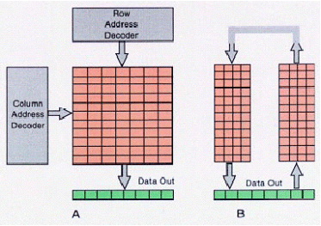
MuxTree: A New Breed of Bio-Inspired Hardware
Chapter 3: The Architecture – The Memory (3)
Simplicity: no address mechanism
Efficiency: memory continuously shifts data (the genetic program)
Accessibility: through data output ports

Slide 26
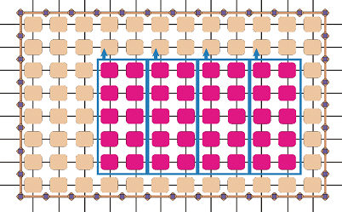
MuxTree: A New Breed of Bio-Inspired Hardware
Chapter 3: The Architecture – The Global Memory
Global memory area composed of multiple basic memory areas
Output data port for each basic memory area
Stored data assembled from each basic memory data output

Slide 27
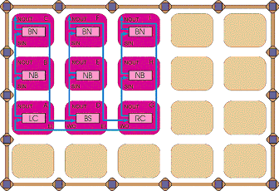
MuxTree: A New Breed of Bio-Inspired Hardware
Chapter 3: The Architecture – The Shifting Process
Data shifted serially
Chain pattern follows the columns
Circle closed at the bottom rightmost molecule

Slide 28
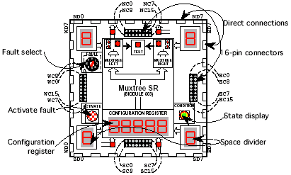
MuxTree: A New Breed of Bio-Inspired Hardware
Chapter 4: The Implementation – Introduction
The prototype: Biodule 603
Use of Xilinx XC4013-PQ240-4 FPGA
Puzzle-like structure assembly of Biodules
Interconnections available via buses
and through entire structure

Slide 29
MuxTree: A New Breed of Bio-Inspired Hardware
Chapter 4: The Implementation – The CREG
Initial configuration register CREG
provided molecular configuration code only
Loaded at run-time
Contents unchanged during operation
Management of FU and SB resources
Current CREG design
Structure modified to also act as a user storage part
Molecular code (MolCode) function modified
Several operating modes available
Resources managed according to storage capacity

Slide 30
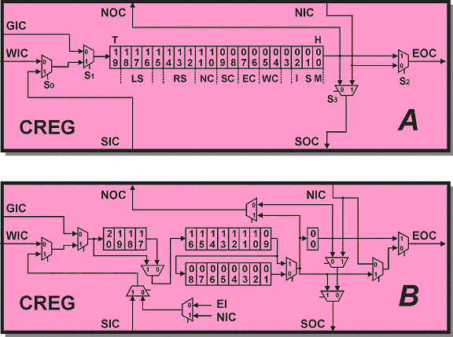
MuxTree: A New Breed of Bio-Inspired Hardware
Chapter 4: The Implementation – The CREG (2)
CREG A: Initial, fixed width configuration register design
CREG B: Current, variable width configuration register design with storage capability

Slide 31
MuxTree: A New Breed of Bio-Inspired Hardware
Chapter 4: The Implementation – The CREG (3)
Several configuration types needed for the memory
Molecule is no border
Molecule is border to the north (with data output)
Molecule is border to the south
Molecule is border to the south
Molecule is not a corner
Molecule is a left corner
Molecule is a right corner
Molecule is a bottom of column (single column case)

Slide 32
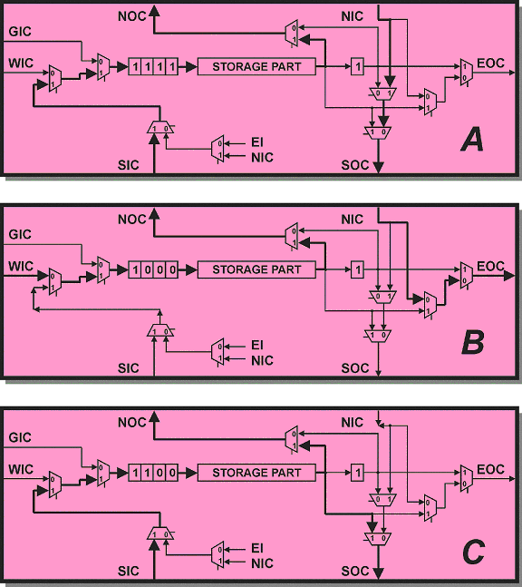
MuxTree: A New Breed of Bio-Inspired Hardware
Chapter 4: The Implementation – The CREG (4)
A: Molecule is no border
B: Molecule is border to the south but no corner
Molecule is border to the north, with data output port

Slide 33
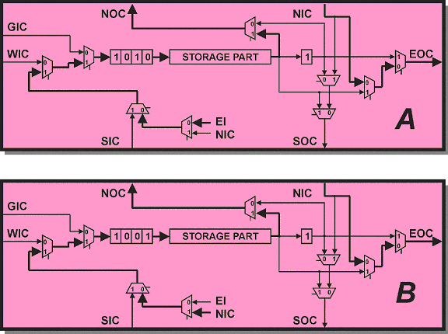
MuxTree: A New Breed of Bio-Inspired Hardware
Chapter 4: The Implementation – The CREG (5)
Molecule is a corner and border to the south
A: Molecule is a left corner
B: Molecule is a right corner

Slide 34
MuxTree: A New Breed of Bio-Inspired Hardware
Chapter 4: The Implementation – The MolCode
Functionality of a molecule determined by the molecular code
Operating modes for a molecule
Logic mode (non-memory mode)
Memory mode
The memory mode
Short memory mode (8 bits storage) with interconnection management (SB)
Long memory mode (16 bits storage) with limited interconnection management (fixed SB)

Slide 35
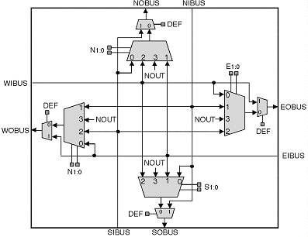
MuxTree: A New Breed of Bio-Inspired Hardware
Chapter 4: The Implementation – The SB
Manages the interconnections
Any routing combination possible

Slide 36
MuxTree: A New Breed of Bio-Inspired Hardware
Chapter 4: The Implementation – The MolCode (2)
The molecular code (MolCode) divided in 2 parts:
The flip-flop FF
The configuration register CREG
FF
CREG20:0
Q
M=CREG20
CREG19:0

Slide 37
MuxTree: A New Breed of Bio-Inspired Hardware
Chapter 4: The Implementation – The Logic Mode
Defined by M = CREG₂₀ = 0
The internal resources of the molecule completely operational (FU, SB)
FF
CREG20:0
21 20 19 16 15 12 11 10 9 8 7 6 5 4 3 2 1 0
Q=Φ M=0
LEFT3:0
RIGHT3:0
N1:0
S1:0
E1:0
W1:0
P
R
EB
H=1
flip-flop
mode
connection block
(CB)
switch block
(SB)
memory and test (MT)
head

Slide 38
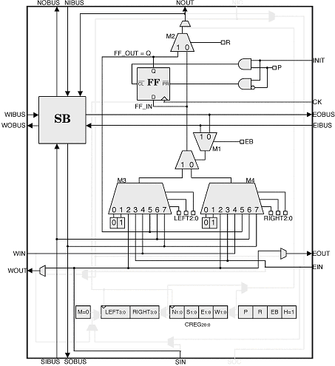
MuxTree: A New Breed of Bio-Inspired Hardware
Chapter 4: The Implementation – The Logic
Mode (2)
All combinational logic resources of the MuxTree® molecule available for the user

Slide 39
MuxTree: A New Breed of Bio-Inspired Hardware
Chapter 4: The Implementation – The Logic
Mode: An Example
A single cell realizing a modulo-4 up-down counter
M=0: Q1, Q0 = 00 → 01 → 10 → 11 → 00 → … (counting up)
M=1: Q1, Q0 = 00 → 11 → 10 → 01 → 00 → … (counting down)
Logic equations:
Q1+ = M (Q1 • Q0 + Q1’ • Q0’ ) + M’ (Q1 • Q0’ + Q1’ • Q0 )
Q0+ = Q0’

Slide 40
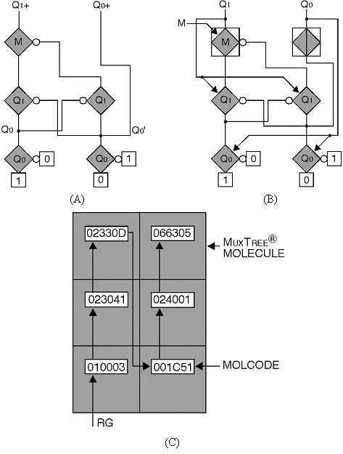
MuxTree: A New Breed of Bio-Inspired Hardware
Chapter 4: The Implementation – The Logic
Mode: An Example (2)
(A) ordered binary decision diagram (OBDD)
(B) multiplexer diagram using MuxTree molecules
(C) The cellular implementation
6 molecules
Logic mode operation

Slide 41
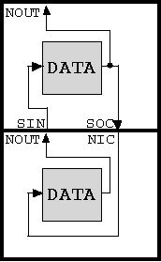
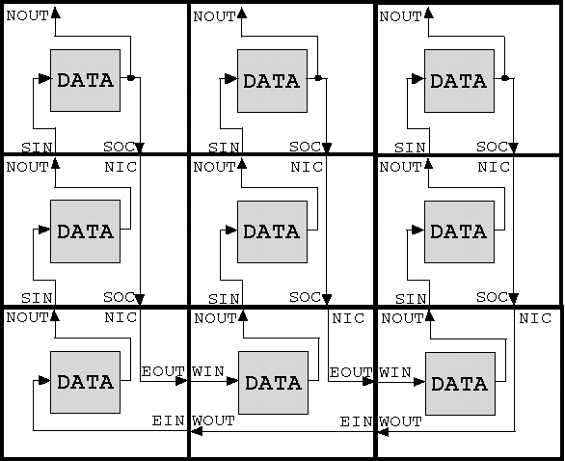
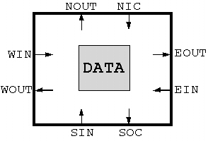
MuxTree: A New Breed of Bio-Inspired Hardware
Chapter 4: The Implementation – The Memory Mode
(C)
(A) (B)
The memory mode: (A) Block schematic of a memory-configured molecule; (B) A macroscopic view of a 3x3 shift-memory area; (C) A 2x1 shift-memory column.

Slide 42
MuxTree: A New Breed of Bio-Inspired Hardware
Chapter 4: The Implementation – The Memory Mode (2)
Defined by M = CREG₂₀ = 1
The internal resources of the molecule partially operational (SB)
MEM₂ | MEM₁ | MEM₀ | Molecule’s position
0 | 0 | 0 | Border to the south BS
0 | 0 | 1 | Lower right corner RC
0 | 1 | 0 | Lower left corner LC
0 | 1 | 1 | Bottom of a single column BC
1 | 0 | x | Border to the north with data output BN
1 | 1 | x | No border NB

Slide 43
MuxTree: A New Breed of Bio-Inspired Hardware
Chapter 4: The Implementation – The Memory Mode (3)
BN
BN
BN
…
BN
BN
NB
BN
(10Φ)
BN
(10Φ)
BN
(10Φ)
NB
NB
…
NB
NB
·
·
·
…
·
·
·
·
·
·
·
BN
(10Φ)
·
NB
(11Φ)
NB
(11Φ)
NB
(11Φ)
·
·
·
·
NB
NB
NB
…
NB
NB
BC
(011)
BCC
LC
(010)
BS
(000)
RC
(001)
LC
BS
…
BS
RC
(A) (B) (C) (D)
Memory structures and their molecular configurations MEM2:0:
(A) The minimal shift-memory structure (2x1);
(B) The general structure of a single column shift-memory;
(C) A 3x3 shift-memory structure;
(D) The general structure of a shift-memory.

Slide 44
MuxTree: A New Breed of Bio-Inspired Hardware
Chapter 4: The Implementation – The Short Memory Mode
Defined by
Q = FF = 0
M = CREG₂₀ = 1
The internal resources of the molecule partially operational (SB)
Storage capacity 8 bits
FF
CREG20:0
21 20 19 12 11 10 9 8 7 6 5 4 3 1 0
Q=0 M=1
DATA7:0
N1:0
S1:0
E1:0
W1:0
MEM2:0
H=1
flip-flop
mode
user data
switch block
(SB)
molecule’s position
head

Slide 45
MuxTree: A New Breed of Bio-Inspired Hardware
Chapter 4: The Implementation – The Long Memory Mode
Defined by
Q = FF = 1
M = CREG₂₀ = 1
No internal resources of the molecule available; however, fixed SB routing provided
Storage capacity 16 bits
FF
CREG20:0
21 20 19 4 3 1 0
Q=1 M=1
DATA15:0
MEM2:0
H=1
flip-flop
mode
user data
molecule’s position
head

Slide 46
MuxTree: A New Breed of Bio-Inspired Hardware
Chapter 4: The Implementation – The Memory
Mode: An Example
A modulo-6 synchronous counter
3 single column shift-memories
each column consisting of 3 molecules operating in long memory mode
each column computing one of DATA bits (DATA₂, DATA₁ and DATA₀)
Each shift-memory column storing 48 bits of data

Slide 47
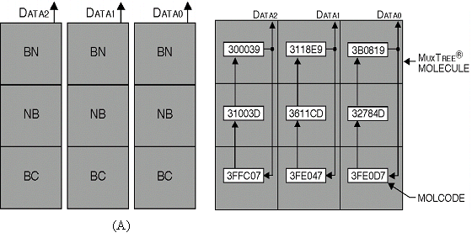
MuxTree: A New Breed of Bio-Inspired Hardware
Chapter 4: The Implementation – The Memory
Mode: An Example (2)
The memory structure using 3 single column shift- memories.
The molecular codes.

Slide 48
MuxTree: A New Breed of Bio-Inspired Hardware
Chapter 4: The Implementation – The Space Divider
A functional cell made of
Properly configured molecules (MolCode defines the logic function, the connections, and/or the memory data) containing the operative genome
Mechanism defining molecular position (including spares) called the space divider, driven by the polymerase genome
COMP_{2:0} | Space divider’s component
100 | Horizontal band H
101 | Vertical band V
110 | Spare horizontal band S
111 | Corner C

Slide 49
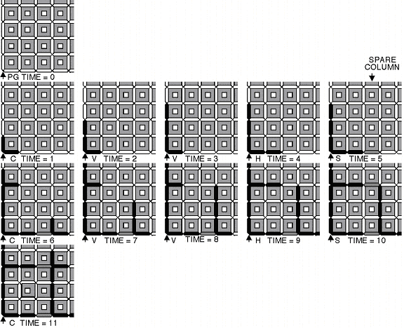
MuxTree: A New Breed of Bio-Inspired Hardware
Chapter 4: The Implementation – The
Space Divider: An Example
A cell made of 3x3 molecules with 1 spare column

Slide 50
MuxTree: A New Breed of Bio-Inspired Hardware
Chapter 4: The Implementation – Fault
Detection and Self Repair
Two levels of self-repair
Molecular level
Cellular level
Self-repair at the molecular level
Based on reconfiguration of molecular array to avoid faulty molecules

Slide 51
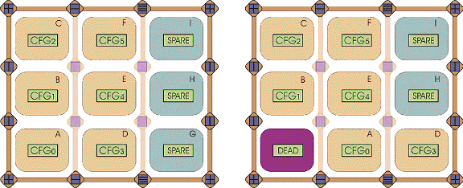
MuxTree: A New Breed of Bio-Inspired Hardware
Chapter 4: The Implementation – Fault
Detection and Self Repair (2)
Repairing the A element

Slide 52
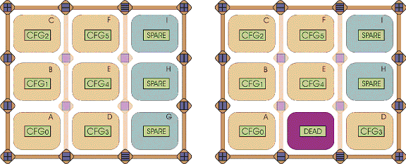
MuxTree: A New Breed of Bio-Inspired Hardware
Chapter 4: The Implementation – Fault
Detection and Self Repair (3)
Repairing the D element

Slide 53
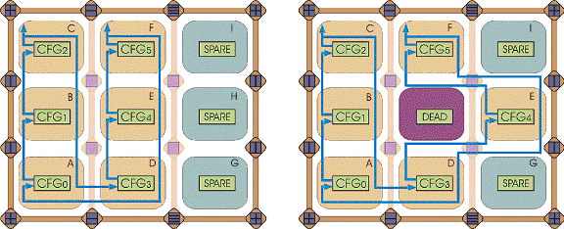
MuxTree: A New Breed of Bio-Inspired Hardware
Chapter 4: The Implementation – Fault
Detection and Self Repair (4)
Details of the repairing process

Slide 54
MuxTree: A New Breed of Bio-Inspired Hardware
Chapter 4: The Implementation – The Hold Mechanism
Memory continuously shifting storage data
Need of a mechanism to disable the shifting when such be the case
Mechanism called “Hold”
Additional signals propagate throughout entire memory area

Slide 55
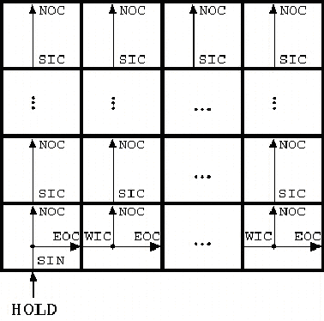
MuxTree: A New Breed of Bio-Inspired Hardware
Chapter 4: The Implementation – The Hold Mechanism (2)
HOLD signal ‘0’ - shift enabled
HOLD signal ‘1’ - shift disabled

Slide 56
Vă mulţumesc!

